Slide 1
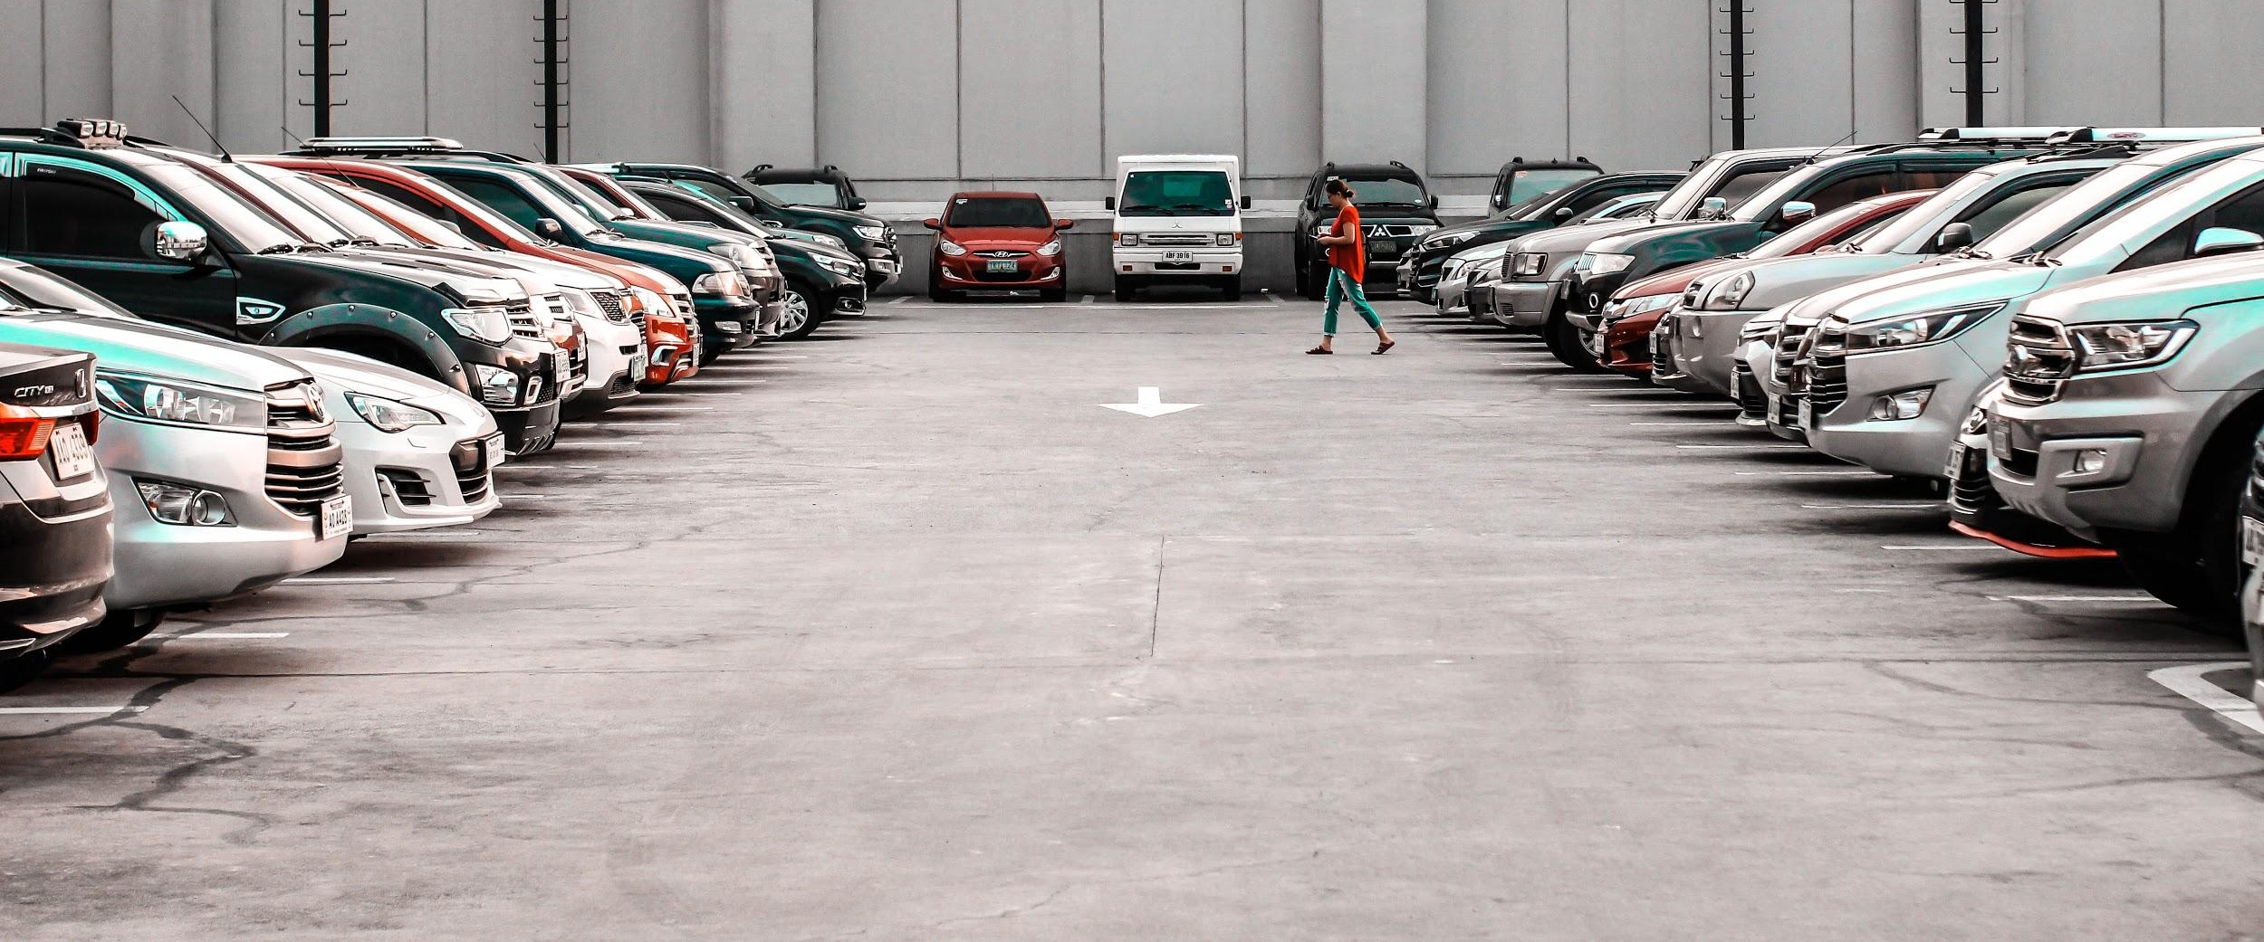
SMART PARKING SYSTEM

Slide 2

PROBLEMS

Slide 3
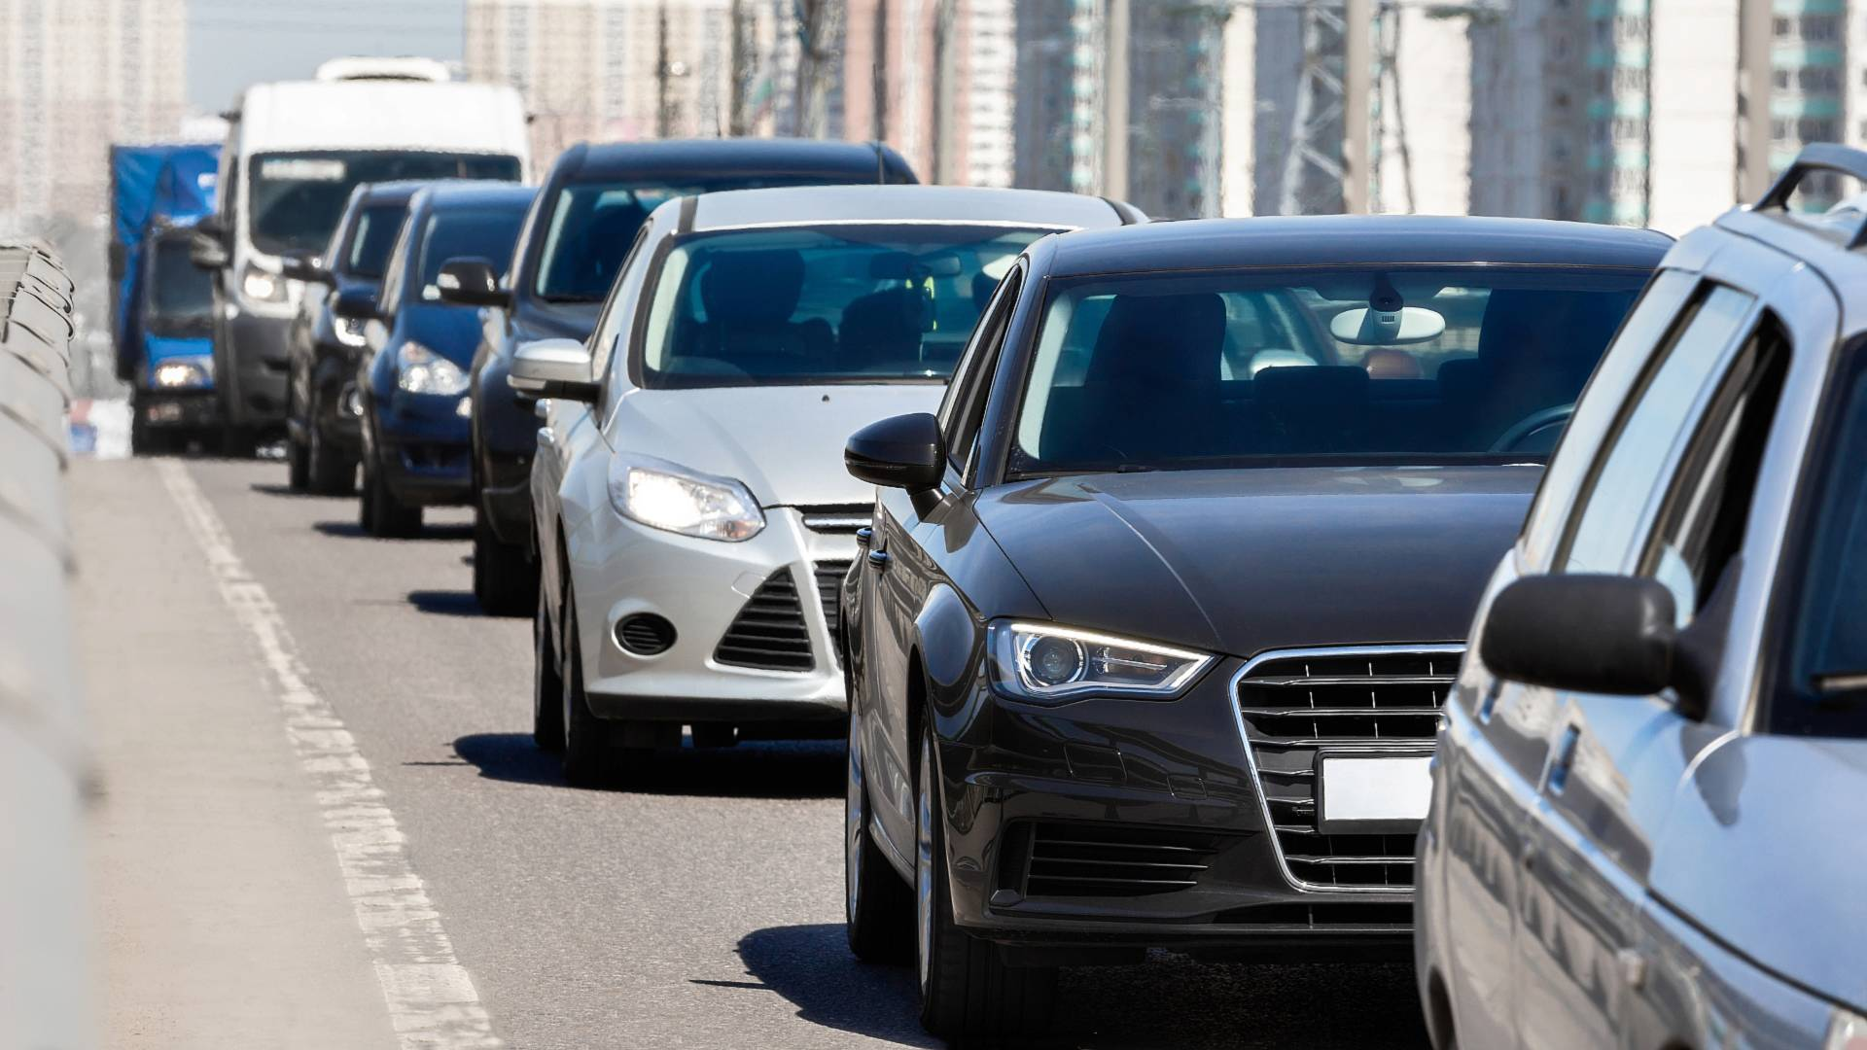
1.
HUGE WAITING QUEUES FOR PARKING SPACES

Slide 4
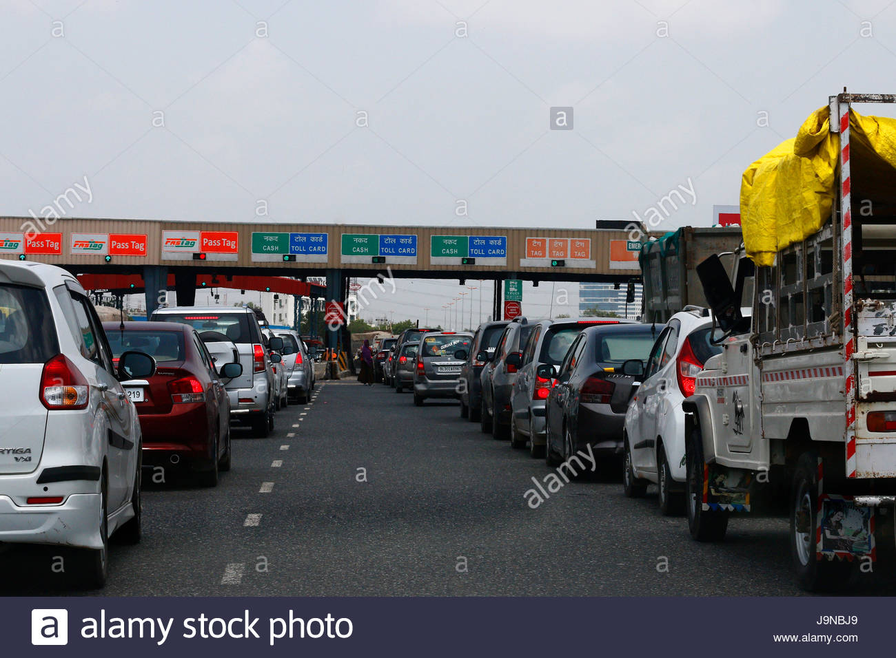
2.
INEFFICIENT PAYMENT SYSTEM

Slide 5
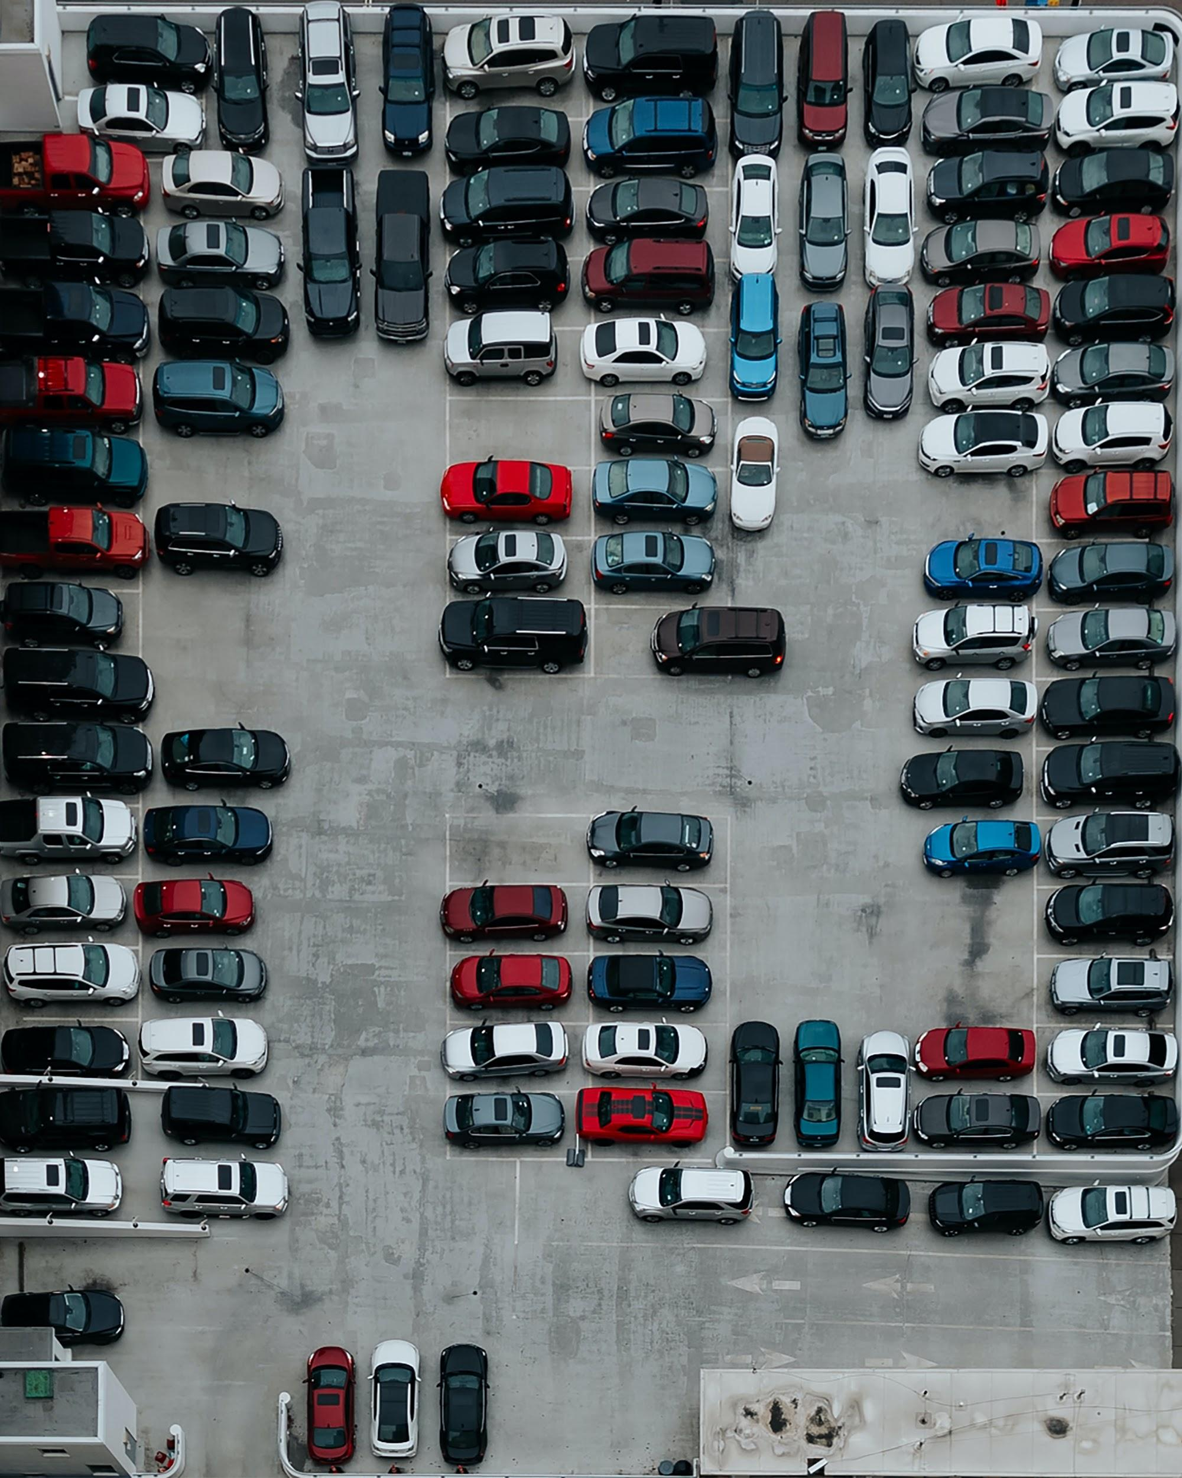
3.
RANDOM SLOT ALLOTMENT

Slide 6
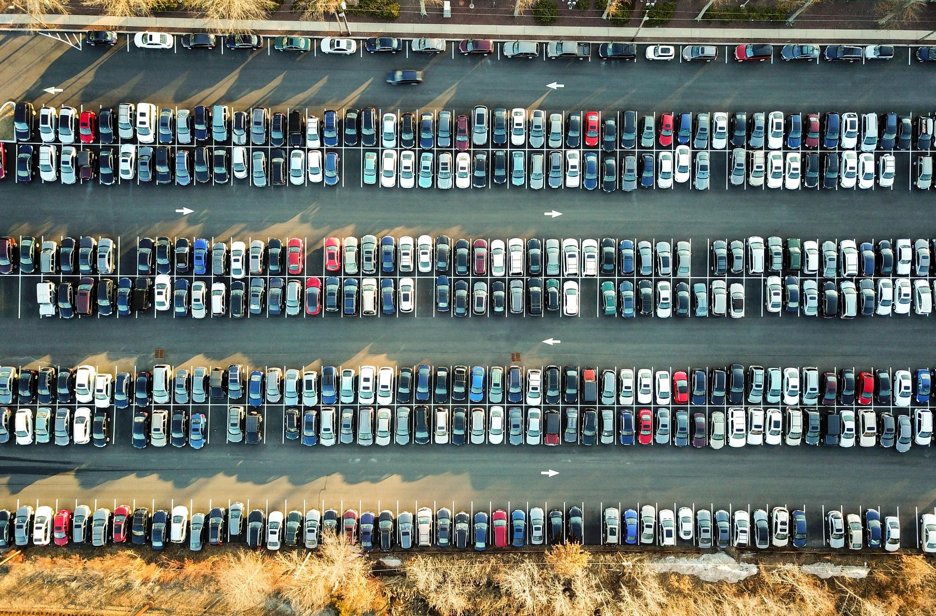
4.
FINDING BACK VEHICLE IN
PARKING LOT

Slide 7

SOLUTION
NO
BRAKES
FROM
ENTRY
TO
EXIT

Slide 8

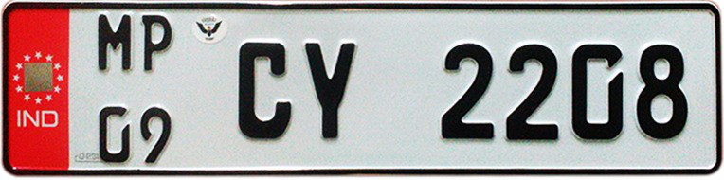
HOW IT WORKS?
STEP 1
Ok Google, I wanna park my car at City Square
STEP 2
Just enter your email and plate number
THAT’S ALL!

Slide 9
STEP 3
Realtime optimized slot allotment using Computer Vision
Slot shared to user with Location
STEP 4
Automated Parking Detection.
TimeStamp Recorded
STEP 5
User can TRACK BACK using location link.
Unpark detected using CV
Rent calculated and added to user for online payment

Slide 10



TECHNOLOGIES USED
Computer Vision
Firebase
Dialogflow

Slide 11

ADVANTAGES
Can Easily be integrated with existing CCTV
Accuracy approx 100%. Since no deep learning, core Image Processing
Intelligent Language Prediction using NLP

Slide 12

ADVANTAGES
Reduction in Fuel Emission
Saving Time and Money
Give Parking Spaces more Public Reach

Slide 13




THANK
YOU
HARIT SAINI
sainiharit2001@gmail.com

